Slide 1
Network Topology Part 1
ETHAN YU

Slide 2
What is Network Topology first of all?

Slide 3
Network topology, is the relationship between computers and other network components.

Slide 4
What are some common words associated with topology?
Earth science
Geology
Geopolitcs
Cartography
Chorography

Slide 5
What is the difference between physical topology and logical topology?

Slide 6
Physical topology is placement of a network component whereas logical topology illustrates how data flows in a network.

Slide 7
How and why is setting up the right topology in the beginning situation important for any organization/company? ie Why is planning it out important?

Slide 8
Well because it plays a important role in the functioning of networks, it also plays an important role in performance, and reduces the operational and maintenance costs as well.

Slide 9
Find example pictures of the three most popular/standard topologies: Bus, Star, Ring and Mesh.

Slide 10
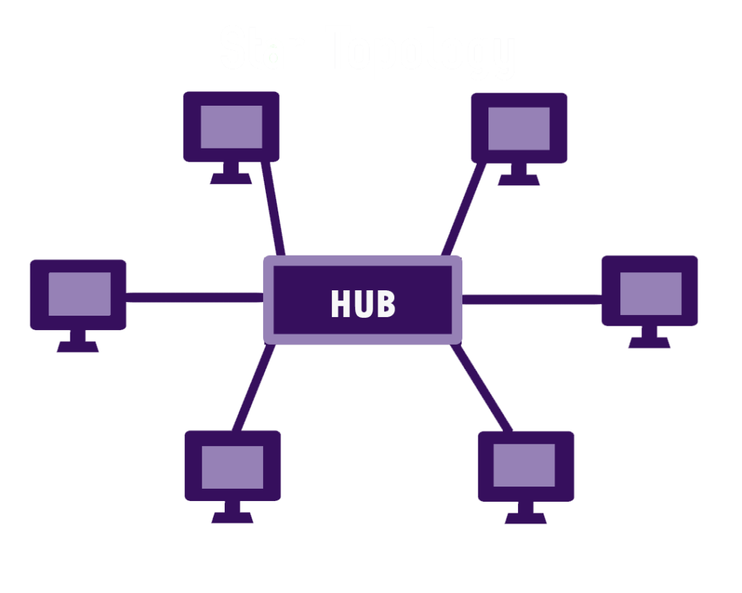
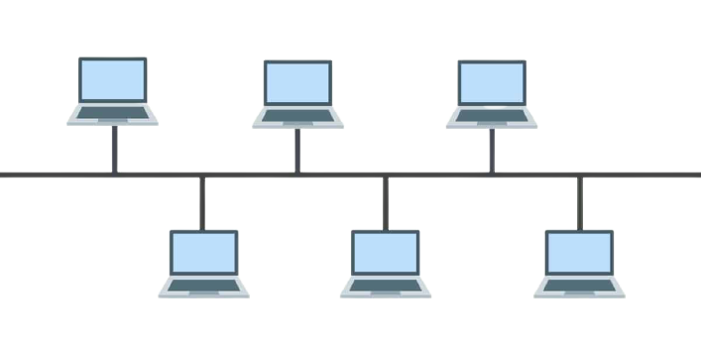
STAR TOPOLOGY
BUS TOPOLOGY

Slide 11
BUS TOPOLOGY:
- Nodes are connected directly via backbone (central cable) that runs up and down a network
STAR TOPOLOGY:
Every host is connected to a central hub

Slide 12
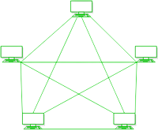
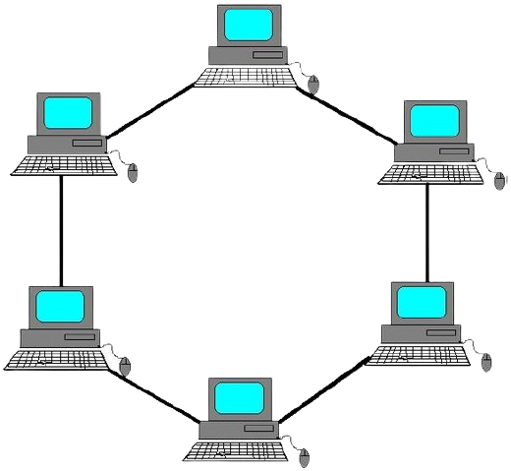
MESH TOPOLOGY
RING TOPOLOGY

Slide 13
RING TOPOLOGY:
Each node connects to 2 other nodes
MESH TOPOLOGY:
No central connection point
Each node is connected to at least one other node, and mostly to more than one
Each node is capable of receiving and sending messages from other nodes

Slide 14
BUS TOPOLOGY
Advanctages | Disadvantages
Easiest topology for connecting computers in a linear fashion | Not good for large networks
Works well when there is a small network | Identification of problem becomes hard if the whole network dies.
Easy to connect / remove devices in the network without effecting any other device | Troubleshooting of individual devices is hard.

Slide 15
STAR TOPOLOGY
Advanctages | Disadvantages
Reliable | Requires more cables then a BUS topology
High performance as no data collisions can happen | Hub requires more resources and regular maintenance
No disruptions to the network when connecting or removing devices. | Extra hardware is needed in which it adds to the cost

Slide 16
RING TOPOLOGY
Advanctages | Disadvantages
Data flows in one direction | If a workstation dies, it affects the whole network
Additional workstations can be added after without impacting the network performance | Expensive
Cheap to install / expand | Hard to troubleshoot the ring

Slide 17
MESH TOPOLOGY
Advanctages | Disadvantages
Failure during a single device won’t break the entire network | Very expensive compared to other topologies
No traffic problem as there is a dedicated point to point links for every computer | Installation is difficult in the mesh
High security / privacy | High risk of redundant connections

